Slide 1

MCA Major Project Mid Term Evaluation
TyreCheck Support AI
Under the guidance of
Dr. Kuntal Gaur
Department of Computer Applications
Faculty of Science, Technology and Architecture
Manipal University Jaipur
By
Awani Vinit Sathe
23FS20MCA00007
2023-25

Slide 2
Outline
Introduction
Motivation
Process Model
Software Requirement Specification (SRS)
Data Flow Diagram (DFD)
Future Scope

Slide 3
Introduction :
TyreCheck Support AI is a specialized language model designed to assist users with tyre-related claims, warranty processes, and general support. It delivers accurate, context-aware, and automated responses, ensuring a seamless customer experience. By streamlining queries and providing instant solutions, it enhances efficiency, reduces response time, and improves customer satisfaction. This AI-driven support system helps users navigate tyre issues with ease and confidence.
Why you should choose us?
TyreCheck Support AI is the ideal solution for handling tyre-related claims, warranty processes, and general support efficiently. Our specialized AI delivers fast, accurate, and context-aware responses, ensuring a seamless customer experience. By automating queries and streamlining issue resolution, we significantly reduce response times, enhance efficiency, and improve customer satisfaction. Whether you need assistance with a claim, warranty details, or troubleshooting tyre-related concerns, our AI-driven system provides instant, reliable solutions. With TyreCheck Support AI, you save time, minimize hassle, and receive expert guidance at your convenience, making tyre support easier, faster, and more effective than ever before.

Slide 4
Motivation :
The need for fast, efficient, and reliable support in the tyre industry has never been greater. Customers often face challenges with claims, warranties, and general tyre-related inquiries, leading to frustration and delays. Traditional support systems are slow, inefficient, and costly for businesses to maintain. To bridge this gap, TyreCheck Support AI provides a smart, automated solution that enhances customer experience, reduces response times, and optimizes business operations.
Our services include:
Tyre Claims Assistance: Streamlining the claims process by providing instant guidance and accurate information.
Warranty Support: Helping users understand warranty coverage, eligibility, and claim procedures.
Automated Query Resolution: Delivering real-time, context-aware responses to common tyre-related questions.
24/7 Availability: Ensuring round-the-clock support without the need for human intervention.
Cost Reduction for Businesses: Minimizing operational expenses by automating customer interactions.
Seamless User Experience: Providing an intuitive and efficient support system that improves customer satisfaction.
With TyreCheck Support AI, businesses can enhance efficiency, and customers can access fast, reliable, and hassle-free tyre support anytime, anywhere.

Slide 5
Process Model :
1. Requirement Analysis & Planning
Gather requirements related to tyre claims, warranty support, and general tyre-related queries.
Define project goals, objectives, and deliverables.
Identify key stakeholders and their expectations.
Outline technological stack and infrastructure requirements (GPT-2 or upgraded LLM, PyTorch, TensorFlow, FastAPI/Flask, React/Streamlit, MySQL/PostgreSQL, Docker, Google Colab).
2. Data Collection & Preparation
Collect relevant tyre-related data from TyreCheck's existing databases, support logs, manuals, FAQs, and previous customer interactions.
Perform data cleaning, normalization, and annotation to create a high-quality dataset for training.
Store the prepared dataset in a structured format (e.g., SQL database).

Slide 6
Process Model :
3. Model Development & Fine-Tuning
Choose an appropriate model architecture (e.g., GPT-2 or upgraded LLM).
Fine-tune the model using TyreCheck’s specific data for tyre-related queries, claims, and warranty processes.
Implement continuous learning techniques to improve the model's performance over time.
Evaluate the model using standard NLP metrics (accuracy, F1-score, precision, recall).
4. Backend Development & API Integration
Develop a backend using FastAPI or Flask for API deployment.
Integrate the fine-tuned model with the backend to provide responses to incoming queries.
Design database architecture using MySQL/PostgreSQL for conversation history and user data storage.
5. Frontend Development & User Interface
Develop a user-friendly chatbot interface using React or Streamlit.
Implement multi-turn conversation handling for context-aware interactions.
Ensure seamless integration with the backend API for query processing.

Slide 7
Process Model :
6. Deployment & Testing
Deploy the entire application using Docker for containerization.
Use Google Colab for initial training and testing.
Conduct end-to-end testing of the system to ensure smooth operation and accurate responses.
Perform user acceptance testing to gather feedback and make improvements.
7. Monitoring, Feedback & Continuous Improvement
Monitor system performance and gather real-time feedback from users.
Continuously update the model with new data and fine-tune for improved accuracy.
Regularly update and maintain the backend and frontend components.
8. Maintenance & Scaling
Ensure the system remains operational with minimal downtime.
Scale the infrastructure as needed to accommodate a growing user base.
Periodically revisit and refine the model architecture for optimal performance.

Slide 8
Software Requirement Specification (SRS) :
Model: GPT-2 (or upgraded LLM) fine-tuned on TyreCheck data.
Frameworks: PyTorch, TensorFlow, or Hugging Face Transformers.
Backend: FastAPI / Flask for API deployment. Database: MySQL / PostgreSQL (for storing conversation history).Frontend: React / Streamlit for chatbot UI (if needed).Deployment: Docker + Google Colab for initial training/testing.

Slide 9
Data Flow Diagram (DFD):
Level 0 (Context Diagram):
The highest-level view of the system. It shows the TyreCheck Support AI system as a single process and how it interacts with external entities.
External Entities:
Users (Customers, TyreCheck Support Staff)
External Databases (Tyre Data Repository, Claims & Warranty Database)
Processes:
TyreCheck Support AI System
Data Flows:
Users send queries related to tyre claims, warranties, or general support to the AI System.
The AI System fetches data from the Tyre Data Repository or Claims & Warranty Database.
Processed responses are sent back to Users.

Slide 10
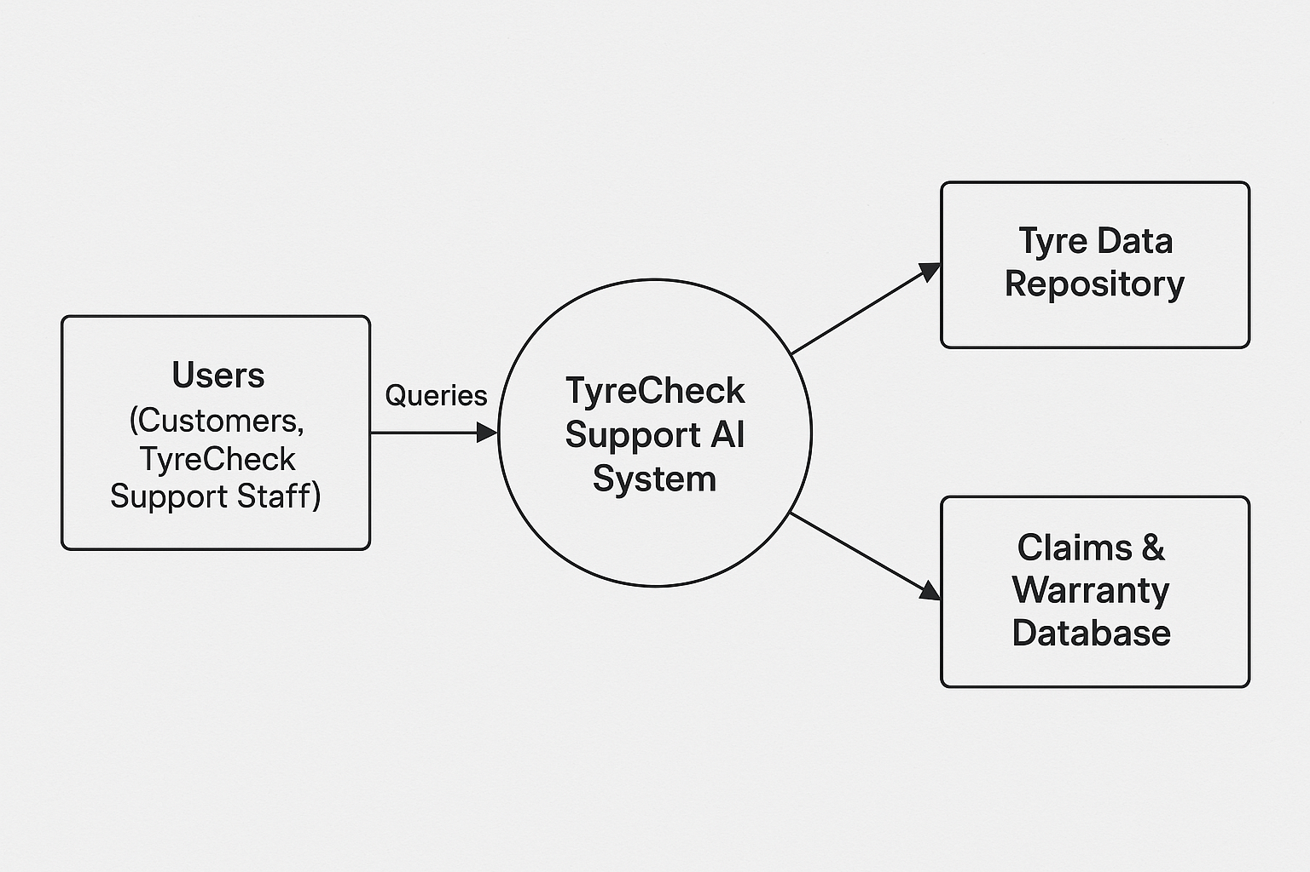
Level 0 DFD:

Slide 11
Data Flow Diagram (DFD):
Level 1 (Detailed View):
Breaks down the TyreCheck Support AI System into specific processes.
Processes:
Query Handling
Model Processing
Claims & Warranty Assistance
Automated Query Resolution
Continuous Learning
Data Stores:
Tyre Data Repository: Stores tyre-related data for accurate responses.
Claims & Warranty Database: Stores records of claims and warranty details.
Conversation History Database: Stores past interactions for context and learning.
Data Flows:
Users send queries → Query Handling → Model Processing.
Model Processing queries data from repositories and databases.
Processed responses are generated and sent to users.
Feedback is recorded for Continuous Learning.
Data stores are updated with new knowledge and conversations.

Slide 12
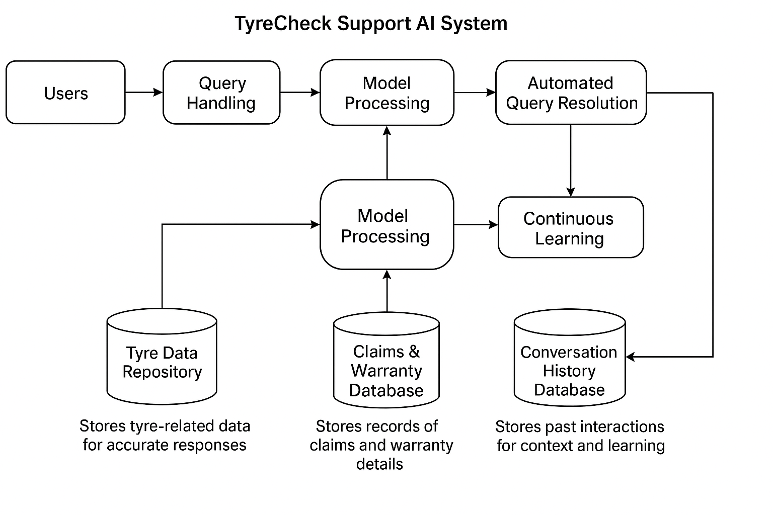
Level 1 DFD:

Slide 13
Future Scope :
1. Advanced LLM Development:
Continuously improve the language model by training with updated tyre-related data, enhancing its contextual understanding and accuracy.
Incorporate multilingual support for a broader, global customer base.
2. Seamless Integration with IoT Systems:
Integrate AI with real-time data from smart tyres, sensors, and connected vehicles to predict tyre health and provide proactive maintenance recommendations.
Enable automated diagnostics and early detection of tyre issues before they become critical.
3. Enhanced Automation of Claims & Warranty Processes:
Fully automate the claims and warranty process with AI, minimizing human intervention and improving response times.
Implement blockchain technology for secure, transparent, and tamper-proof claim management.
4. Improvement in NLP Capabilities:
Enhance the model’s ability to understand complex, multi-turn conversations for a smoother user experience.
Implement sentiment analysis to provide empathetic, user-friendly interactions.

